Slide 1


Noida Institute of Engineering and Technology, Greater Noida
Noida Institute of Engineering and Technology, Greater Noida
CLOUD AND EDGE COMPUTING
Unit:2
Cloud Enabling Technologies
Jaya Nidhi Vashishtha
Assistant Professor, CSE-IOT
NIET, Greater Noida
B Tech 6th Sem
Unit2

Slide 2
Syllabus
UNIT-II Cloud Enabling Technologies: 8 HOURS Service Oriented Architecture – REST and Systems of Systems – Web Services – Publish Subscribe Model – Basics of Virtualization – Types of Virtualization – Implementation Levels of Virtualization – Virtualization Structures – Tools and Mechanisms – Virtualization of CPU – Memory – I/O Devices –Virtualization Support and Disaster Recovery.
Unit2

Slide 3
Prerequisites
The student should have knowledge of:
Basics of OS.
Basic concepts of computer fundamentals of computer system and cloud and edge computing
Unit2

Slide 4


Unit Objective
To study the Service Oriented Architechture.
To study the basic concepts about Underlying Principles of Virtualization.
Understanding the Implementation details of Virtualization.
Understanding of tools & mechanism of virtualization.
Overview of Virtualization Support & Disaster Recovery.
Unit2

Slide 5

Unit Contents
Service Oriented architecture : Rest & Systems of system
Web Services : Publish Subscribe Model
Basics of Virtualization : Types & Implementation
Structures : Tools & Mechanisms
Virtualization of CPU – Memory- I/O devices
Virtualization : Support & Disaster Recovery
Unit2

Slide 6

Services Oriented Architecture
Service-Oriented Architecture (SOA) is a style of software design where services are provided to the other components by application components, through a communication protocol over a network.
In service oriented architecture, a number of services communicate with each other, in one of two ways: through passing data or through two or more services coordinating an activity.
Unit2

Slide 7
Services Oriented Architecture
Characteristics Of Service-Oriented Architecture
Business value
Strategic goals
Intrinsic inter-operability
Shared services
Flexibility
Evolutionary refinement
Unit2

Slide 8
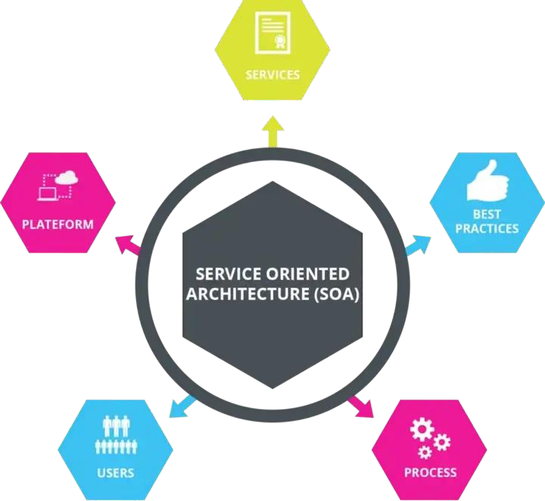
Services Oriented Architecture
Fig:1 SOA Architechture
Unit2

Slide 9
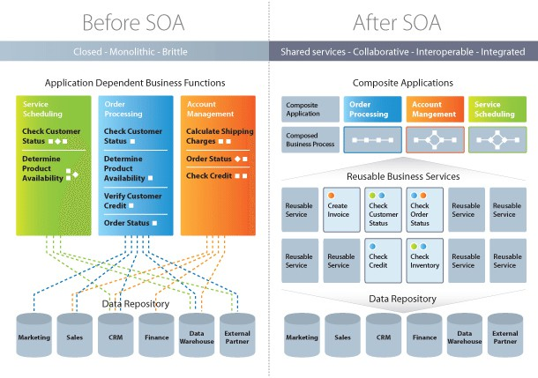
Services Oriented Architecture
Fig:2 SOA Architecture Before vs. After
Unit2

Slide 10

Recap
Service-Oriented Architecture (SOA):
Involves software design where services communicate over networks.
Features include business value, interoperability, shared services, and flexibility.
Unit2

Slide 11
Daily Quiz
1. What is the primary purpose of Service-Oriented Architecture (SOA)? a) To increase hardware performance b) To organize services to communicate over a network c) To replace all legacy systems d) To focus solely on data storage
Answer: b) To organize services to communicate over a network
3. What is a fundamental characteristic of SOA services? a) Platform independence b) Synchronous communication only c) Always requiring human intervention d) Exclusively built using SOAP protocol
Answer: a) Platform independence
2. Which of the following best describes a service in SOA? a) A standalone application with no integration capabilities b) A software component that performs a specific task and communicates using standardized protocols c) A protocol used for data transfer d) A large, monolithic application
Answer: b) A software component that performs a specific task and communicates using standardized protocols
4. Which protocol is commonly associated with Service-Oriented Architecture? a) TCP/IP b) SOAP c) FTP d) SMTP
Answer: b) SOAP
Unit2

Slide 12

Rest & Systems of System
REST stands for Representational State Transfer, and API stands for
Application Program Interface. REST is a software architectural style
that defines the set of rules to be used for creating web services.
A Restful system consists of a:
client who requests for the resources.
server who has the resources.
Unit2

Slide 13
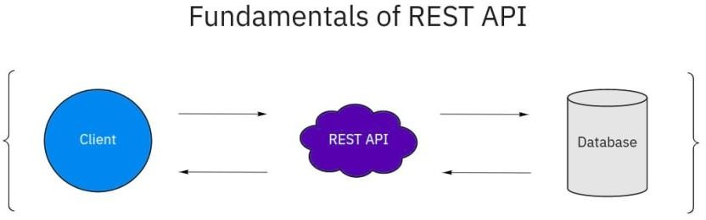
Rest & Systems of System
Fig:3 Rest API
Unit2

Slide 14
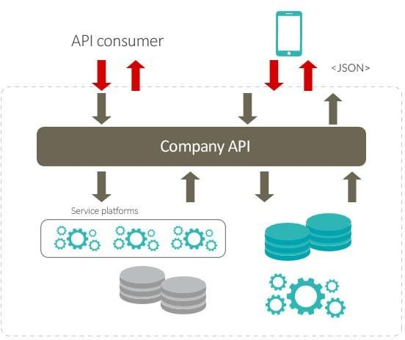
Rest & Systems of System
Fig:4 Rest & Systems of System
Unit2

Slide 15
Recap
Rest & Systems of System:
REST (Representational State Transfer) defines rules for creating web services.
Restful systems involve a client requesting resources and a server providing them.
Unit2

Slide 16
Daily Quiz
1. What does REST stand for in the context of web services? a) Remote Encapsulation of Secure Transactions b) Representational State Transfer c) Reliable Enterprise System Technology d) Reusable Service Toolkit
Answer: b) Representational State Transfer
3. What best describes a System of Systems (SoS)? a) A single large system designed to solve specific tasks b) A collection of systems that operate independently but collaborate for a higher goal c) A monolithic system operating as a centralized entity d) A layered system with tightly integrated components
Answer: b) A collection of systems that operate independently but collaborate for a higher goal
2. Which of the following is a defining characteristic of a RESTful service? a) Communication through SOAP envelopes b) Stateless communication between client and server c) Tight coupling of client and server d) Use of XML exclusively for data exchange
Answer: b) Stateless communication between client and server
4. How does REST support the design of a System of Systems? a) By enforcing rigid rules for integration between systems b) By providing a flexible and scalable architectural style with standard communication protocols like HTTP c) By requiring all subsystems to share the same technology stack d) By limiting interactions to synchronous communication only
Answer: b) By providing a flexible and scalable architectural style with standard communication protocols like HTTP
Unit2

Slide 17
Web Services
A web service is a standardized method for propagating messages between client and server applications on the World Wide Web.
The web service would be able to provide the functionality to the
client that invoked the web service.
A web service is a set of open protocols and standards that allow data exchange between different applications or systems.
Unit2

Slide 18
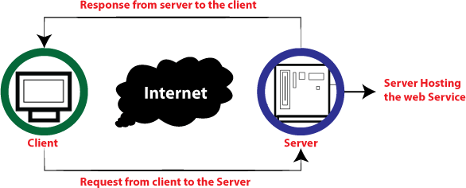
Web Services
How does web service work?
Fig:5 Web Services Work
Unit2

Slide 19
Recap
Web Services:
A web service is a standardized method for propagating messages between client and server applications on the World Wide Web.
A web service is a standardized method for propagating messages between client and server applications on the World Wide Web.
Unit2

Slide 20
Daily Quiz
1. What is a web service? a) A hardware device used for internet connectivity b) A platform-independent method for enabling communication between applications over the web c) A protocol for downloading web pages d) A tool for creating static websites
Answer: b) A platform-independent method for enabling communication between applications over the web
3. What protocols are commonly used for communication in web services? a) HTTP, SOAP, and FTP b) SMTP, DNS, and SNMP c) POP, IMAP, and SSH d) ARP, RARP, and ICMP
Answer: a) HTTP, SOAP, and FTP
2. Which of the following is a key feature of web services? a) Dependency on the same operating system b) Platform and language independence c) Restricted to REST architecture d) Requires only offline communication
Answer: b) Platform and language independence
4. Which of the following statements is true about SOAP-based web services? a) SOAP uses only JSON for data exchange. b) SOAP services are highly dependent on the underlying platform. c) SOAP is a protocol designed for secure, structured, and extensible message exchange. d) SOAP does not support stateful operations.
Answer: c) SOAP is a protocol designed for secure, structured, and extensible message exchange.
Unit2

Slide 21

Publish Subscribe Model
Publish/subscribe messaging, or pub/sub messaging, is a form of asynchronous service-to-service communication used in server less and micro services architectures.
In a pub/sub model, any message published to a topic is immediately
received by all of the subscribers to the topic.
Unit2

Slide 22
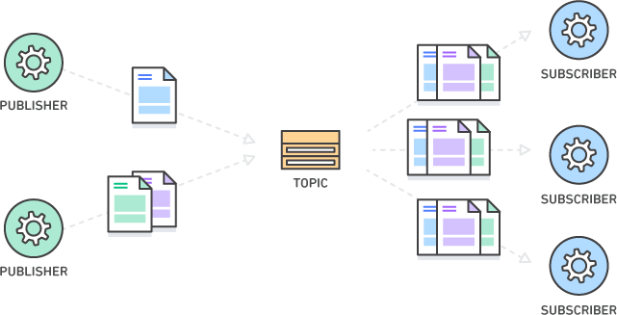
Publish Subscribe Model
Fig:6 Publish Subscribe Model
Unit2

Slide 23
Recap
Publish subscriber Model:
Publish/subscribe messaging, or pub/sub messaging, is a form of asynchronous service-to-service communication used in server less and micro services architectures.
Unit2

Slide 24
Daily Quiz
1. What is the primary purpose of the Publish-Subscriber model? a) To directly connect a publisher with a specific subscriber b) To facilitate asynchronous communication between publishers and subscribers c) To send emails between users d) To store large volumes of data
Answer: b) To facilitate asynchronous communication between publishers and subscribers
3. What is a key advantage of the Publish-Subscriber model? a) It allows tight coupling between components. b) It ensures scalability and decoupling of components. c) It requires all systems to use the same technology stack. d) It reduces the need for middleware.
Answer: b) It ensures scalability and decoupling of components.
2. Which of the following is true about the Publish-Subscriber model? a) Subscribers must explicitly request updates from publishers. b) Publishers send updates to a centralized message broker, not directly to subscribers. c) All subscribers must have the same format and structure. d) It only supports synchronous communication.
Answer: b) Publishers send updates to a centralized message broker, not directly to subscribers.
4. In the Publish-Subscriber model, what is the role of a message broker? a) To directly execute the subscriber's logic b) To mediate between publishers and subscribers by managing message delivery c) To store messages permanently for offline use d) To transform messages into specific formats
Answer: b) To mediate between publishers and subscribers by managing message delivery
Unit2

Slide 25

Basics Of Virtualization
Virtualization in Cloud Computing :
Virtualization is the "creation of a virtual (rather than actual) version of something, such as a server, a desktop, a storage device, an operating system or network resources".
In other words, Virtualization is a technique, which allows to share a single physical instance of a resource or an application among multiple customers and organizations.
Unit2

Slide 26
Basics Of Virtualization
Consider a company that needs servers for three functions:
Store business email securely
Run a customer-facing application
Run internal business applications
Each of these functions has different configuration requirements:
The email application requires more storage capacity and a Windows operating system.
The customer-facing application requires a Linux operating system and high processing power to handle large volumes of website traffic.
The internal business application requires iOS and more internal memory (RAM).
Unit2

Slide 27
Types of Virtualization:
Types of Virtualization
Hardware Virtualization.
Operating system Virtualization.
Server Virtualization.
Storage Virtualization.
Unit2

Slide 28

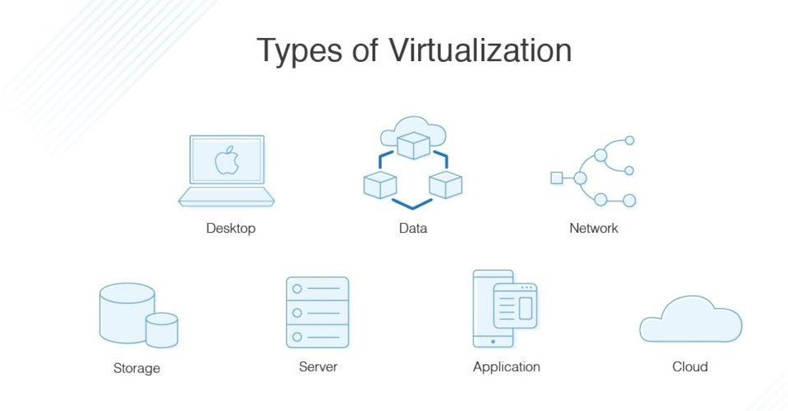
Types of Virtualization
Fig:7 Types of Virtualization
Unit2

Slide 29

Implementation levels of Virtualization
There are a total of five levels that are commonly used as follows.
1) Instruction Set Architecture Level (ISA)
2) Hardware Abstraction Level (HAL)
3) Operating System Level
4) Library Level
5) Application Level
Unit2

Slide 30
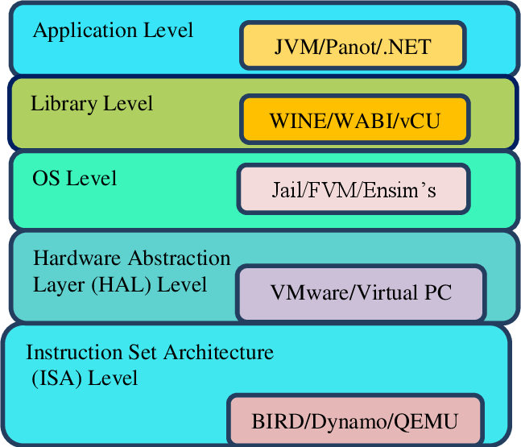
Implementation levels of Virtualization
Fig:8 Implementation Levels of Virtualization
Unit2

Slide 31
Recap
Virtualization:
Basics of Virtualization.
Types of Virtualization.
Implementation Levels of Virtualization.
Unit2

Slide 32
Daily Quiz
1. What is virtualization in computing? a) The process of permanently deleting data b) The creation of a virtual version of computing resources such as hardware, storage, or network c) The development of a physical machine for testing d) A method to increase the speed of hardware processors
Answer: b) The creation of a virtual version of computing resources such as hardware, storage, or network
3. At what level is hardware virtualization typically implemented? a) BIOS level b) Hypervisor level c) Application layer d) Operating system kernel
Answer: b) Hypervisor level
2. Which of the following is NOT a type of virtualization? a) Hardware virtualization b) Software virtualization c) Power virtualization d) Network virtualization
Answer: c) Power virtualization
4. What is a key benefit of virtualization? a) Increased dependency on physical hardware b) Reduced system performance and resource utilization c) Enhanced resource utilization and cost efficiency d) Limitation to a single operating system per machine
Answer: c) Enhanced resource utilization and cost efficiency
Unit2

Slide 33

Virtualization Structures
Virtualization is achieved through the software known as virtual machine monitor or the hypervisor.
Bare-metal virtualization hypervisors: (TYPE I HYPERVISOR). Is deployed as a bare-metal installation (the first thing to be installed on a server as the operating system will be the hypervisor).
Unit2

Slide 34
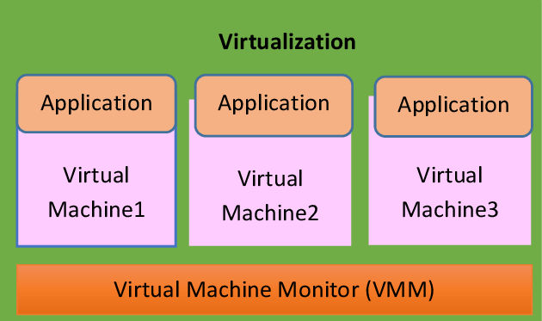
Virtualization Structures
Fig:9 Virtualization Structures
Unit2

Slide 35

Virtualization Structures : Tools & Mechanisms
After virtualization, a virtualization layer is inserted between the hardware and the operating system.
Depending on the position of the virtualization layer, there are several classes of VM architectures,
namely the hypervisor architecture, parameter.
Virtualization, and host-based virtualization. The hypervisor is also known as the VMM (Virtual Machine Monitor). They both perform the same virtualization operations.
Unit2

Slide 36

Virtualization Of CPU
To support virtualization, processors such as the x86 employ a special running mode and instructions,
known as hardware-assisted virtualization.
To save processor states, mode switching is completed by hardware. For the x86 architecture, Intel and AMD have proprietary technologies for hardware-assisted virtualization.
Unit2

Slide 37

Virtualization Of CPU, Memory I/O Devices
A VM is a duplicate of an existing computer system in which a majority of the VM instructions are executed
on the host processor in native mode.
The critical instructions are divided into three categories: privileged instructions, control-sensitive instructions, and behavior-sensitive instructions.
Privileged instructions execute in a privileged mode and will be trapped if executed outside this mode.
Control-sensitive instructions attempt to change the configuration of resources used.
Behavior-sensitive instructions have different behaviors depending on the configuration of resources,
including the load and store operations over the virtual memory.
Unit2

Slide 38

Virtualization Support & Disaster Recovery
What is Virtual Disaster Recovery?
Virtual disaster recovery is a type of DR that typically involves replication and enables a user to fail
over to virtualized workloads.
For the most efficient virtual disaster recovery, an organization should copy VM workloads off-site on a regular basis.
Unit2

Slide 39
Virtualization Support & Disaster Recovery
Benefits of Virtual Disaster Recovery
Virtualization provides flexibility in disaster recovery. When servers are virtualized, they are
containerized into VMs, independent from the underlying hardware.
An organization does not need the same physical servers at the primary site as at its secondary
disaster recovery site.
Unit2

Slide 40
Recap
Virtualization Structures:
Virtualization Structures – Tools and Mechanisms
Virtualization of CPU – Memory – I/O Devices
Virtualization Support and Disaster Recovery.
Unit2

Slide 41
Daily Quiz
2. What does the term "Virtualization Mechanism" typically refer to? a) A strategy for creating physical hardware b) Techniques and components used to implement virtualization, such as hypervisors and virtual machine monitors c) A specific hardware-only solution for disaster recovery d) Software used only for network security
Answer: b) Techniques and components used to implement virtualization, such as hypervisors and virtual machine monitors
4. What challenge is addressed by I/O device virtualization? a) Ensuring that all virtual machines have direct access to physical storage devices b) Preventing communication between virtual machines c) Managing access to hardware resources among multiple virtual machines without conflict d) Reducing power usage of I/O devices
Answer: c) Managing access to hardware resources among multiple virtual machines without conflict
5. How does virtualization enhance disaster recovery? a) By eliminating the need for data backups b) By enabling quick recovery through virtual machine replication and snapshot features c) By completely preventing hardware failures d) By creating redundant physical systems for every application
Answer: b) By enabling quick recovery through virtual machine replication and snapshot features
3. What is the primary role of CPU virtualization? a) To allow multiple CPUs to function as one b) To allow multiple virtual machines to share the physical CPU resources efficiently c) To enhance the physical CPU's clock speed d) To reduce the power consumption of CPUs
Answer: b) To allow multiple virtual machines to share the physical CPU resources efficiently
Unit2

Slide 42

MCQs
1) Does publish() method accepts arbitrary arguments.
(a) 5
(b) 3
(c) 1
(d) 2
2) Point out the wrong statement.
Abstraction enables the key benefit of cloud computing: shared, ubiquitous access
Virtualization assigns a logical name for a physical resource and then provides a
pointer to that physical resource when a request is made
None
All of above
3) Publishing messages is handled through Class.
Client()
Server()
Publish()
Batch()
Unit2

Slide 43

MCQs
Which of the following describes a message-passing taxonomy for a component-based architecture that provides services to clients upon demand?
SOA
EBS
GEC
All of the mentioned
SOA an extension of the Service Oriented Architecture to respond to events that occur as a result of business processes.
2
3
4
All of the above
Client() class provides to create topics.
Software
Classes
Methods
Batch
Unit2

Slide 44
MCQs
4) What does CVE in SOA design stand for?
Casual Vector
Casual Machine
All of the above
None
5) The message in pub/sub is an opaque blob of .
Binomial
Canonical
Both
None
Unit2

Slide 45
Previous Year Question Paper
2022-23
2023-24

Slide 46
Expected university question
What are different cloud enabling technologies?
What is the main purpose of service oriented architecture.
What are the 6 constraints of REST?
What are the different components of web services.
What do you mean by virtualization in cloud computing.
What is RESET and systems of systems?
Explain system of systems applications and examples.
What are the components of publish subscribe model?
How virtualization is used in cloud computing?
What is virtualization explain the virtualization of CPU and memory?
Unit2

Slide 47
Weakly Assignment
What are the different components of web services.
Define various types of virtualization.
Define Virtualization Structures
What is Service Oriented Architecture with example.
Explain the working of Web service.
Describe the characteristics of web services.
What is the key principle of Service-Oriented Architecture?
What is the role of broker in Publish Subscribe model?
What Are The Main Benefits Of SOA?
State the Pros and cons of Virtualization in Cloud Computing
Unit2

Slide 48
Summary
This Unit consist of all the benefits of cloud and edge computing are-
Service Oriented architecture : Rest & Systems of system
Web Services : Publish Subscribe Model
Basics of Virtualization : Types & Implementation
Structures : Tools & Mechanisms
Virtualization of CPU – Memory- I/O devices
Virtualization : Support & Disaster Recovery
Unit2

Slide 49
Reference
https://en.wikipedia.org/wiki/Cloud_computing
https://www.javatpoint.com/cloud-computing
https://www.javatpoint.com/cloud-service-models
https://www.javatpoint.com/cloud-service-provider-companies
https://www.javatpoint.com/what-is-parallel-computing
https://www.geeksforgeeks.org/introduction-to-parallel-computing/
https://www.geeksforgeeks.org/evolution-of-cloud-computing/
https://www.slideshare.net/joyschandran/underlying-principles-of-
parallel-and-distributed-computing
https://www.techslang.com/definition/what-is-cloud- provisioning/#:~:text=Also%20referred%20to%20as%20%E2%80%9Con,an d%20down%20when%20demands%20decrease.
Unit2

Slide 50


Unit2

Slide 51
